Slide 1
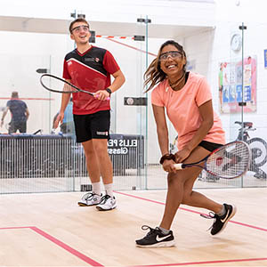
Junior Squash Group Sessions at
Hook Community Squash Club
For juniors, aged 7 to 17 year olds.
All standards welcome including absolute beginners.
One FREE “taster” session for any junior who has not attended previously.
Professional coach with over 20 years’ experience.
Rackets and balls provided, just bring indoor shoes
FREE JUNIOR TASTER SQUASH SESSIONS
WHEN: Every Monday or Friday after-school or Wednesday before school. All during school term times. Starting 11TH September
WHERE: Hook Community Squash Club, Ravenscroft, Hook RG27 9NN
INFO: gary@thesquashcoach.co.uk or visit www.thesquashcoach.co.uk or www.hooksquash.org.uk
Gary Hales (mobile: 07854 519797)
Level 3 Professional Squash & Racketball Coach
Enhanced DBS Checked

Slide 2
Aldermaston Squash Club
For fun, fitness & friendships!
FREE 6 X 1 hour coaching course over 6 weeks (non-members only).
For beginners, aimed at 20-40 year olds.
Professional coach with over 20 years’ experience.
Free squash membership for 3m.
Rackets and balls provided, just bring indoor shoes
FREE BEGINNERS’ SQUASH SESSIONS
WHEN: Every Tuesday, starting 5th September @ 5pm or 6pm.
WHERE: Aldermaston Squash Club, Reading RG7 4PR
INFO: chris.bulley1@gmail.com or gary@thesquashcoach.co.uk or visit aldermastonsquash.co.uk/free-squash-coaching
Funded by Berkshire Squash, in association with Aldermaston Squash Club. Please click on the squash ball to enter.

